Slide 1
Fitness Trackers Usage
Tyler Macek
Date: 6/5/21

Slide 2
Agenda
Project Overview
Data & Analysis
Recommendations
Additional Steps
Questions
Appendix

Slide 3
Project Overview

Slide 4
Overview
Find trends from customer usage of smart devices and correlating those into a marketing strategy for the Leaf
Notes:
This project’s primary focus is to use data from how customers use their fitness trackers and figure out we can market ours more effectively.

Slide 5
Data and Analysis

Slide 6
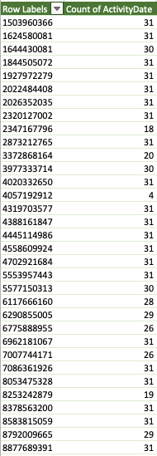
Data – What, Where
30 users selected, 2016
Data used from Kaggle FitBit Fitness Tracker Data
Contained incomplete data, 5 users removed in total
Notes:
The data used was from 30 users over the course of 30 days that is stored on Kaggle. This is data from FitBit users, which encompasses steps, activity levels, and sleep. The main limitation is the small scope of the amount of users and data in the study and it is not known how the users were chosen or their gender. The data needed some cleaning, there were four users that had 20 or less entries and were removed from the analysis because of their sporadic usage. There was one user that only appeared in the sleep data and was removed from analysis. With the remaining data, I was able to successfully clean and analyze the data and it contained some insights.

Slide 7
Usage of device and lack

Slide 8
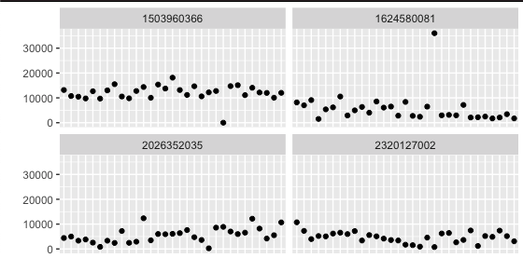
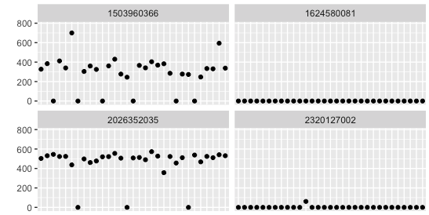
Trends
Most users tracked their activity
Sleep was not tracked as much
Steps taken over the month
Minutes of Sleep over the month
Notes:
During the analysis, most of the participants used their health tracker for their waking hours, logging their workouts, steps, and calories burned. Sleep was another story, of the 29 remaining participants, only 13 had a more consistent recording of their sleep, 5 of them tried it and didn’t continue, while the rest didn’t track at all. The biggest take away is that when someone buys an activity tracker, the sleep functionality is an afterthought or is not of importance.

Slide 9
Next steps

Slide 10
More Information
Set up a survey of Leaf users
Find out feature(s) that are least used
Sleep might be one
Analyze the data
Notes:
Using these findings, it would be advised to survey Leaf users to find out about their usages and what they would like to know more about. It is possible to find that Leaf users are not using the sleep functionality because of they didn’t know, they don’t wear a device when they arrive home, or some other reason. Once we know this information, we can analyze it and make some better decisions. With this data, we can target users and new users better.

Slide 11
Questions?

